Slide 1
The Changing Earth
‘Dem bones:
The Fossil Record

Slide 2
Fossils
Until recent times, the belief that these fossils were the remains of once-living creatures was not widely agreed upon.
Few people could imagine the process of fossilization in which organic materials turned into stone.

Slide 3
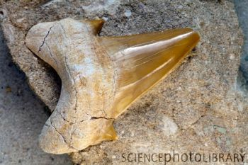
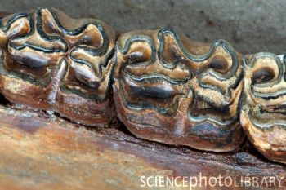
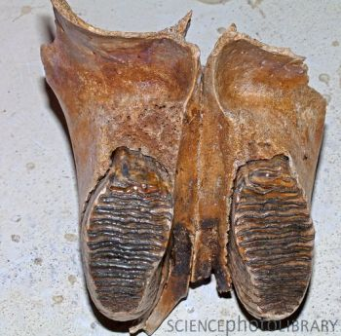
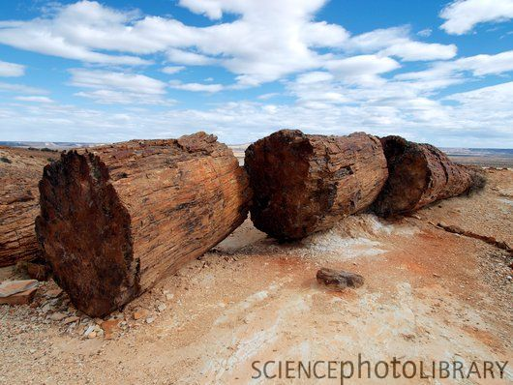
What can make up Fossils
actual remains

Slide 4
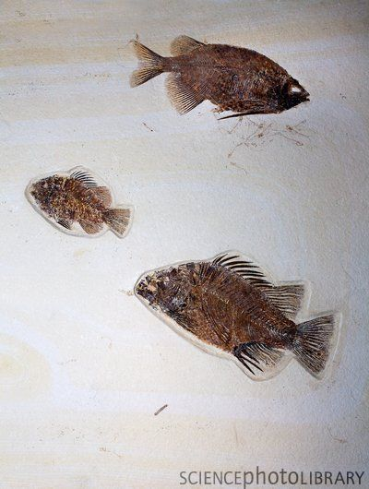
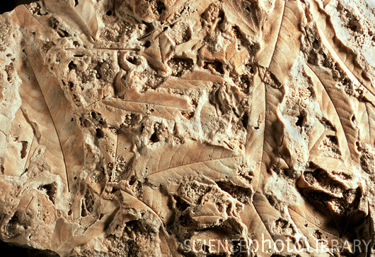
What can make up Fossils
molds or imprints

Slide 5
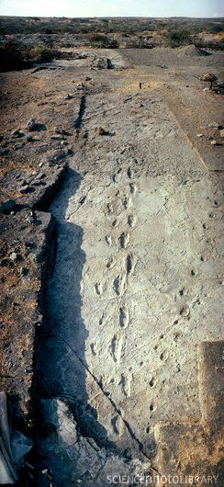
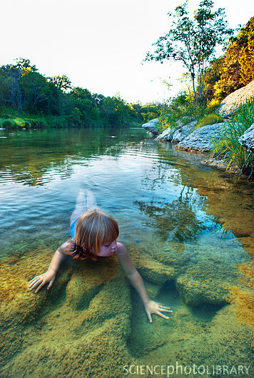
What can make up Fossils
Caption: Trail of hominid footprints fossilized in volcanic ash. This 70 metre trail was found by Mary Leakey's expedition at Laetoli, Tanzania in 1978. It dates from 3.6 million years & shows that hominids had acquired the upright, bipedal, free- striding gait of modern man by this date. The trail probably belongs to Australopithecus afarensis & dates from 3.7 to 3.0 million years ago. The footprints show a well developed arch to the foot & no divergence of the big toe. They are of two adults with possibly a third set belonging to a child who walked in the footsteps of one of the adults. The prints to the far right belong to an hipparion, an extinct three-toed horse.
tracks

Slide 6
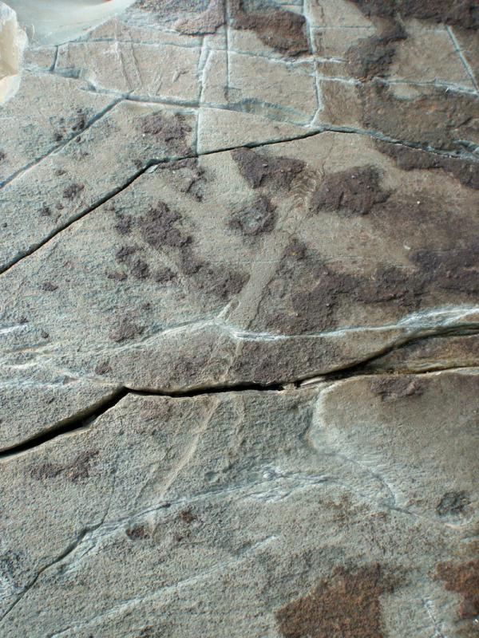
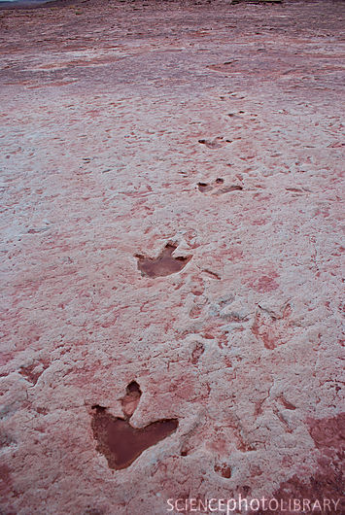
What can make up Fossils
trails or burrows

Slide 7
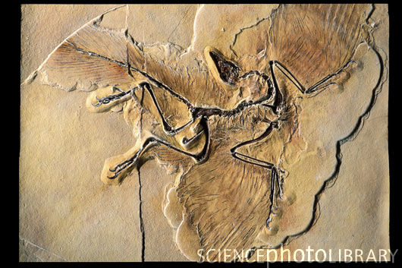
How do fossils help us understand evolution?
Transition Fossils:
is any fossilized remains of a life form that exhibits traits common to both an ancestral group and its derived descendant group.
Example: Dinosaurs→ Birds
Archaeopteryx
Transitional fossil showing Dinosaurs→ Birds

Slide 8
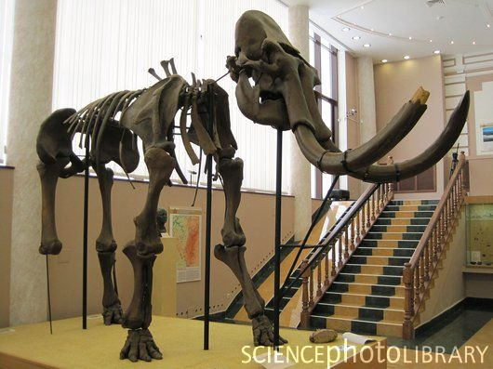
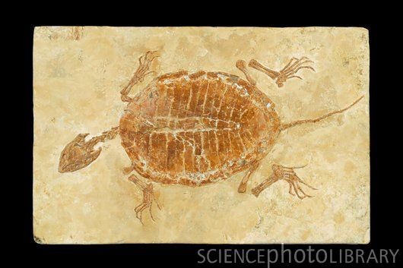
How do fossils help us understand evolution and the earths past history?
PaleoClimate:
•Paleoclimate: It uses a variety of proxy methods from the Earth and life sciences to obtain data previously preserved within (e.g.) rocks, sediments, ice sheets, tree rings, corals, shells and microfossils; it then uses these records to determine the past states of the Earth's various climate regions and its atmospheric system.
types of fossils indicate climate
Look at the pictures below and discuss with a partner what the climate would have looked like.

Slide 9
Tonguestones
Tonguestone is a rock that is so named because they looked like dragon tongues.
In the latter part of the seventeenth century, a physiologist named Nicolas Steno, was dissecting a large shark’s head in Florence, he noticed that the teeth strongly resembled tonguestone rock
Steno proposed that tonguestones were actually remnants of once-living shark teeth.
shark-tooth fossils are very common, largely because sharks continually shed their teeth; as many as 24,000 in the lifetime of some species

Slide 10
Tonguestones
Although this was a keen observation, he didn’t stop there. Instead, he followed up his observation by asking some very basic questions.
  How can fossilized shark teeth become imbedded in rock that is on land high above sea level?
  What process caused these teeth to become fossils embedded in solid rock?
Steno reasoned that the rock surrounding the tooth fossils must have been in fluid form when it was deposited around the teeth. The fluid must have later hardened into solid rock.

Slide 11
Tonguestones
A modern explanation would be that the shark teeth sank to the bottom of the ocean and were later buried by sediment.
As layers of sediment continued to fall, the weight increased to the point where sediments surrounding the shark teeth were compacted into solid rock.
Hypothesize about which was deposited first – the shark teeth or the strata below the shark teeth. (Why?)
  The strata must have been deposited before the shark teeth because layers are built on top of one another. Lower layers are older than higher layers.

Slide 12
Recall: The Law of Superposition
Law of Superposition: higher strata (layers) in a sequence of rock layers are younger than lower strata
  the oldest rock is at the bottom of the sequence and the most recent layer is at the top
Which type of fossil dating uses this law, absolute dating, or relative dating?
  relative dating - the process of placing rocks and geological structures in the correct chronological order based on their relative position

Slide 13
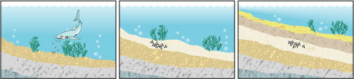
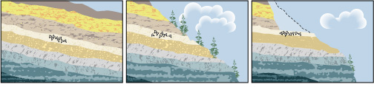
Practice problem
The following drawings represent the steps required to make tonguestone. Put them in order from first to last.

Slide 14
How can fossilized shark teeth become imbedded in rock that is on land high above sea level?
A shark living in an ancient ocean sheds its teeth. | The teeth sink to the bottom of the ocean and are buried in fluid sediment. | Over time, the sediment hardens and becomes sedimentary rock.

Slide 15
How can fossilized shark teeth become imbedded in rock that is on land high above sea level?
Over time, more and more layers are deposited and the sea level drops or the layers are lifted to become dry land. | Erosion creates an outcropping, exposing part of the layer. | The site is excavated to expose the fossils.

Slide 16
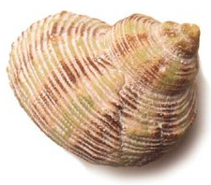
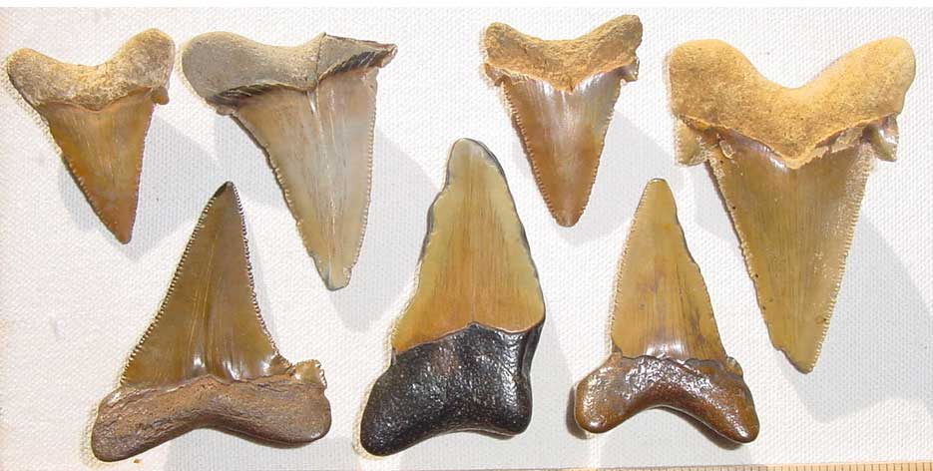
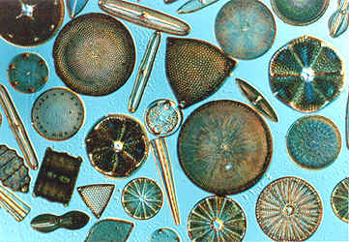
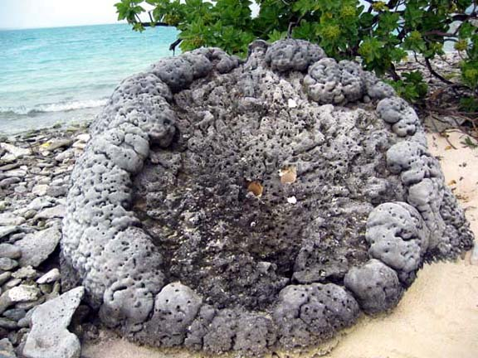
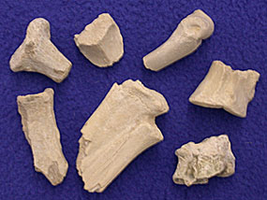
What can be fossilized?
Any organic material that is “hard”. This includes
  shells,
  teeth,
  bones,
  corals,
  diatoms
    just to name a few….

Slide 17
How can something be fossilized?
One process involves the item being buried, especially somewhere there is minerals (one such place is in or by a water source). Then over many years the minerals seep into the pores of the “hard” parts, which over time replaces the actual “hard” part to create a mineralized form of the “hard” part.
Another process involves the item being buried and then compressed into the rock layers beneath it. And over time the organism decays and what’s left behind is an impression of itself.

Slide 18
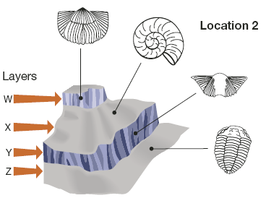
Smith’s Observations
William Smith noticed that certain distinctive fossils kept re-appearing at each surveyed location.
Further, these distinctive fossils always appeared in the same order within the layers of rock at each location.

Slide 19
So what does this mean?
If a distinctive fossil existed only for a limited period of time, then rocks containing that fossil must correspond closely in age with other rocks that contain that same fossil.
These distinctive fossils are like an index; they establish a common time of origin for widely dispersed rock layers.
That’s why these fossils are called index fossils.

Slide 20
Index fossils:
a fossil used to determine the relative age of a layer in a stratigraphic sequence or to match stratigraphic sequences from different locations
they are the better preserved fossils and are from a very short-lived species which is known to have existed during a specific geological time period
How does an index fossil work?
  scientists would use their different processes of dating to put a particular age to an index fossil.
  when they come across a rock layer that contains that particular index fossil they would know the approximate age of the rock layer no matter where they found in it the world.

Slide 21
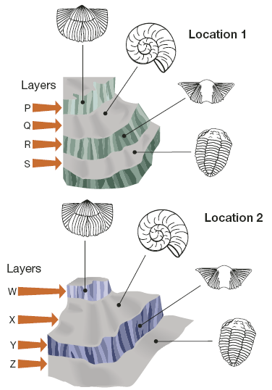
Practice problems:
Determine the oldest layers of rock at Location 1 and 2.
Determine the youngest layers of rock at Locations 1 and 2.
Conclude which layer in Location 1 contains rock of roughly the same age as the rock in layer X of Location 2.

Slide 22
Practice problems:
Solutions
S and Z are the oldest, because they are on the bottom.
P and W are the youngest, because they are on the top.
Layer Q is roughly the same age as layer X because they contain the same index fossil (ammonite)

Slide 23
Activity
Can stratigraphic sequences from different locations be matched by using index fossils to form on larger sequence?
Step 1: Use the scissors to cut out the eight fossil cards from the handout.
Step 2: Place the fossil card with the letter M in the lower left-hand corner of your workspace. This represents the oldest rock layer, so it is on the bottom.
Step 3: Find a rock layer on a fossil card that contains at least one of the fossils you found in the oldest rock layer. This rock layer is younger, as indicated by the presence of a new fossil species. Place this rock layer above the oldest rock layer.

Slide 24
Step 4: Repeat the process outlines in step 3 to select a fossil card to be the third rock layer.
Step 5: Check your work. If a fossil is present in layer 1, it should NOT disappear from layer 2 and then re-appear in layer 3. Since extinction is forever, once a fossil disappears from the fossil record it does not return. If necessary, re-adjust the fossil cards you chose for layers 2 and 3.
Step 6: Repeat the previous three steps for each of the remaining fossil cards. When you are finished you should have the rock layers assembled into a stratigraphic sequence.

Slide 25
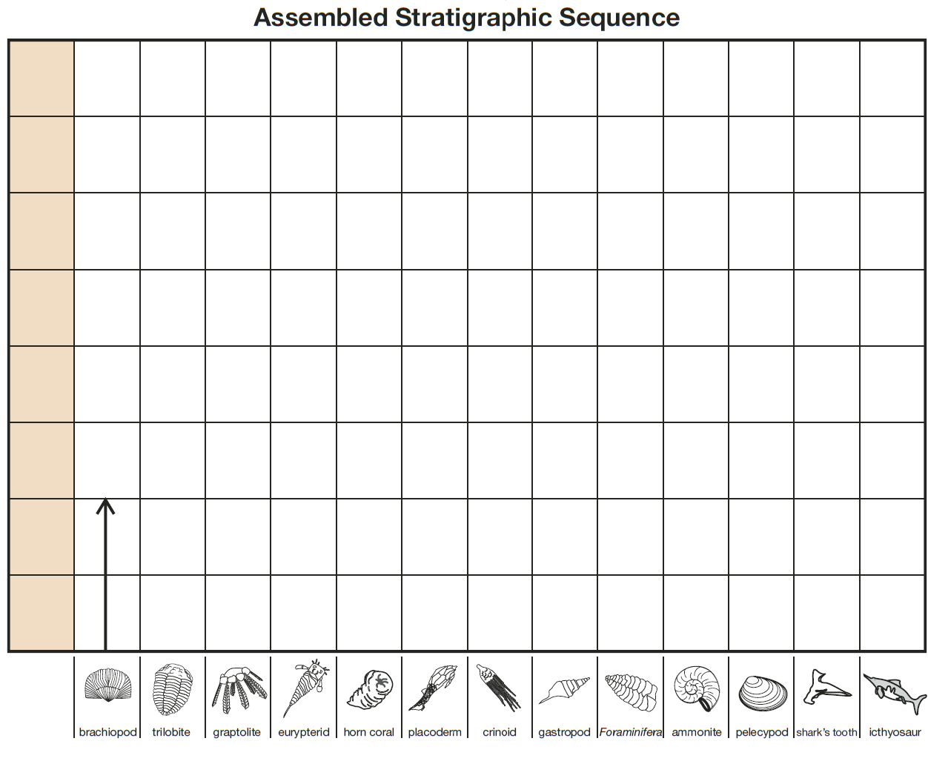
Activity (solution)
The correct sequence from youngest to oldest spells out the word organism.

Slide 26
More on index fossils:
Graptolite, placoderm, and ammonite are the most suitable index fossils because they are only found during a short amount of geological time.
A good index fossil:
  Appears only briefly in the geological record
  Has a wide geographical distribution
  Is easily recognizable.

Slide 27
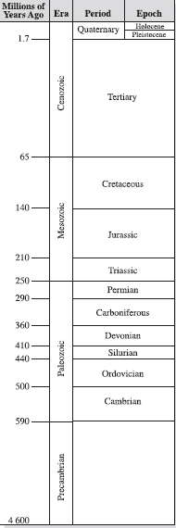
Wealth from Ancient Seas
Fossils are not just important for geological dating – they also form the primary fuel we rely upon in Alberta
  Geologists suspect most of Alberta became submerged at the bottom of a tropical sea by the end of the Ordovician Period.
  Over the next 200 million years, sea levels rose and fell
  When it was submerged, Alberta became the home to a now extinct group of sponges.
    These sponges secreted a brittle calcium carbonate skeleton that, together with coral, became the main component of huge reefs that eventually occupied hundreds of square kilometres of the underwater environment.
    these porous reefs were 10-storeys tall in some places, and became the storage containers for life that would later form our petroleum reserves

Slide 28
Making Petroleum
Over the next 200 million years microscopic marine organisms—mostly plankton—had been living and dying in the warm tropical seas that often covered most of Alberta.
Geologists suspect that the dead plankton remains created thick blankets of organic ooze that fell to the bottom of the sea to become a food source for bacteria.
The bacteria were thought to have removed most of the oxygen and nitrogen from this organic matter to leave mostly carbon and hydrogen, which are the main ingredients of petroleum

Slide 29
Making Petroleum
During the next 380 million years, this layer of organic material was subjected to heat and pressure that encouraged chemical reactions to occur
Thousands of metres of sediment were piled on top.
  The accumulated top layer of sediment eventually changed into rock.
Once the hydrocarbons had been converted into liquids, the pressure from above pushed these materials into more porous rock—the fossilized remnants of the ancient reefs.
Since the type of rock formed above and below the reservoir of petroleum was impermeable shale, the petroleum had no place to go.
  This is why a large concentration of petroleum in subsurface rock is called a petroleum trap.

Slide 30
The Burgess Shale
In Chapter 2 you have been introduced to three fossils: a trilobite, Canadia, and Hallucigenia. Samples of all three fossils have been found in the shale on the side of Mount Wapta, about 80 km west of Banff. This location is known as the Burgess Shale, and it’s considered by many scientists to be the most important source of Cambrian fossils on Earth.
Geologists have evidence that more than 500 million years ago, the organisms now fossilized in the Burgess Shale were inhabiting a shallow area close to the shore of a tropical sea.

Slide 31
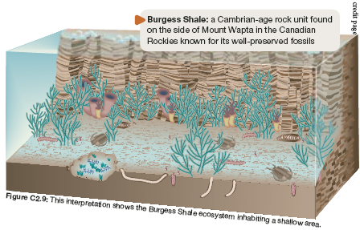
The Burgess Shale

Slide 32
*The Burgess Shale*
From page 333 of your textbook, identify a trilobite, an Canadia, and a Hallucigenia. Describe the location of each of these organisms in the illustration.

Slide 33
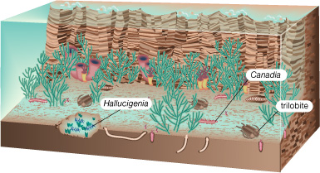
The Burgess Shale
They are all swimming along the bottom.

